Slide 1
NODE.JS

Slide 2
NODE.JS
“Node.js® is a JavaScript runtime built on Chrome's V8 JavaScript engine. ”
event-driven
non-blocking I/O model (asynchronous)

Slide 3
MISCONCEPTION
UI Framework
Not related to AngularJS, ReactJS ,BackboneJS

Slide 4
Misconception
Related to Backend language like Ruby,Python(Interpreters).
But NODE.JS is used as part of UI workflow process
Grunt
Gulp
Webpack, Browserify
Npm
Bower

Slide 5
Web Development
NODE.JS is Back End or Server Side.
HTML,CSS,*.JS is Front End.
Typically used in Web Tier Layer of Application Architecture.

Slide 6
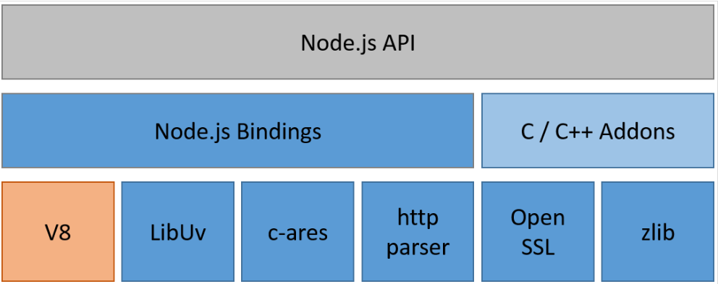
NODE.JS Architecture

Slide 7
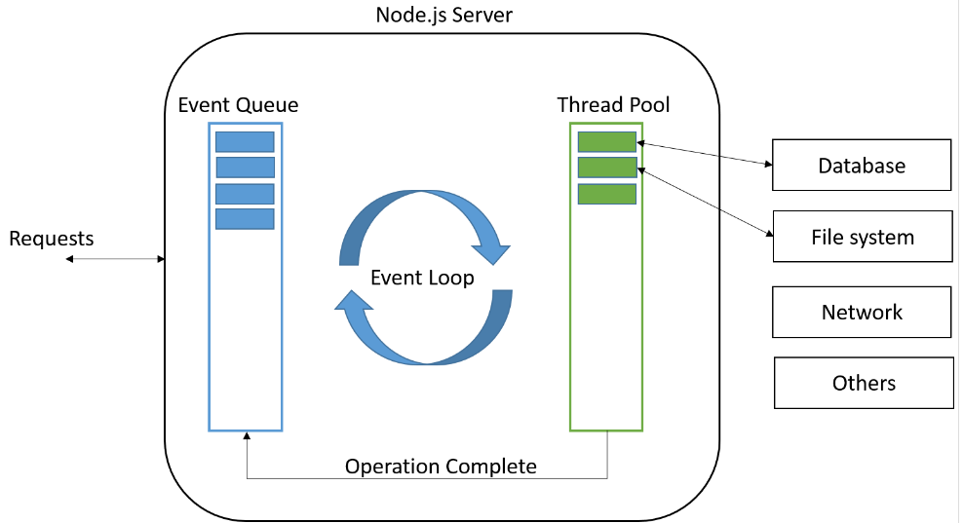
Event Loop

Slide 8
Major Features
Single Threaded
Event Loop
Non Blocking I/O

Slide 9
Event Loop
Single Threaded process.
Event Loop is not part of application.
Event Loop is part of NodeJS Runtime.
EventLoop is architectural decision.
You can’t see EventLoop .
You don’t include it .
It is there by default .

Slide 10
NODEJS ADVANTAGES
Scalability
Lower memory usage
Lower CPU overhead

Slide 11
NODE.JS USE CASES
I/O bound application
Real Time application/streaming
API’s (REST+JSON)
Command Line utitlites

